Slide 1

Supporting Economic Vitality
Minnesota MPO Summer Conference Presentation
August 28, 2019
Notes:
Beginning of a journey to better understand a little discussed aspect of what we do.

Slide 2
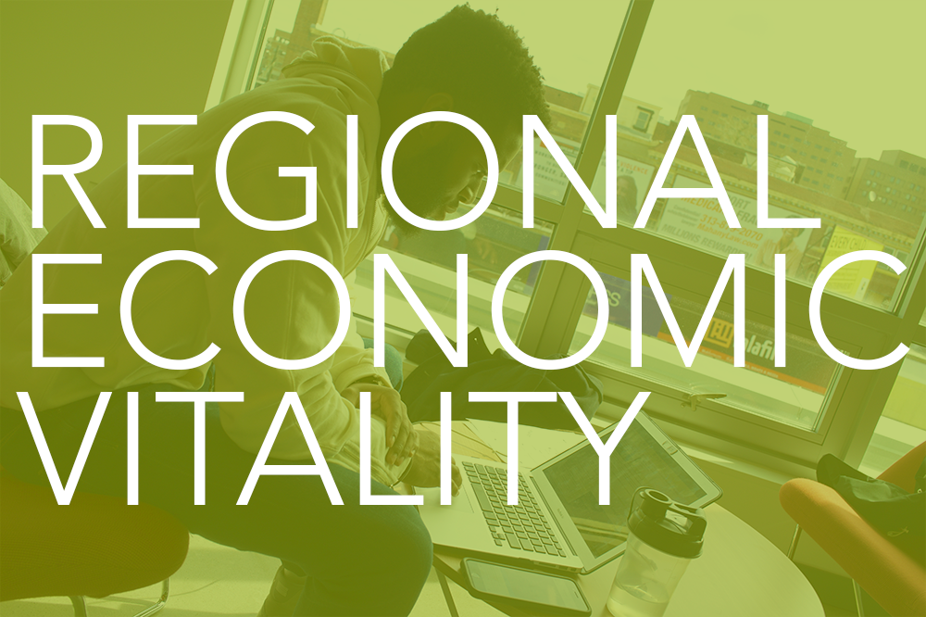

Requirement
“Support the economic vitality of the metropolitan area, especially by enabling global competitiveness, productivity, and efficiency”*
What the heck is “economic vitality”?
*23 CFR § 450.306(a)(1)

Slide 3





Dictionary
(Economic) Vitality
  (Economic) Strength
  (Economic) Vigor
  (Economic) Power
  Capacity for (economic) survival

Slide 4
This -> Becomes -> This
“Support the economic vitality of the metropolitan area, especially by enabling global competitiveness, productivity, and efficiency”*
What the heck is “economic vitality”?
*23 CFR § 450.306(a)(1)
Support the economic, strength, vigor, and power of the region by enabling global competitiveness, productivity, and efficiency
  Economic strength and power are the goal
    Strategies to get there:
      Global competitiveness
      Productivity
      Efficiency

Slide 5
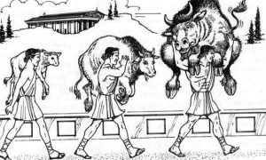
What is Economic Power or Strength?
Seems relative, like a comparison
  REM – “competitiveness” is a strategy to reach “strong”
  Comparing our economic output to the output of other regions will help us know if we are “strong”

Slide 6

Economic Growth vs. Economic Development
Economic Growth
  An increase in the output of goods and services over time
  Typical measurements:
    Gross National Product
    Gross Domestic Product
  Narrow
  Quantitative
Economic Development
  Well being and quality of life
    econ growth + education + standard of living + technological advancement + social development + institutions + crime rate + safe drinking water + healthcare + + +
  Typical measurements:
    Gross National Product
    Population Growth
    Infrastructure
    Adult Literacy Rates
    Life Expectancy & Infant Mortality
    Labor Force Structure
  Broad
  More qualitative (though some things are quantitatively measurable).
Notes:
Two phrases often used interchangably

Slide 7
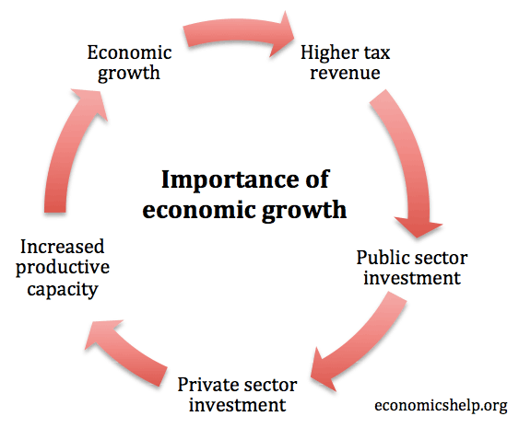
Economic Development Graphically

Slide 8
What Did Congress Mean by
“Economic Vitality”?
“Support the economic vitality of the metropolitan area, especially by enabling global competitiveness, productivity, and efficiency”
  “Productivity” is a measurement of output => economic growth
  “Efficiency” is a measurement of both outputs and inputs => economic development
  “Global competitiveness” – another relative term – comparison is necessary
    I think really means “attractiveness to business”?
      Tax breaks
      Infrastructure
      Quality of workforce
        Education & schools
        Availability of healthcare
        Quality of life
        Leisure activities
      This would also seem to lean more toward economic development

Slide 9

The Case for Economic Development
Economic growth, by itself, does not seem to sufficiently capture the intent of the Federal regulations
Other planning factors
  Safety
  Security
  Environmental Protection
  Energy Conservation
  Quality of Life

Slide 10

Are Freight Trucks Enough?
Freight trucks are a measure of output – more output, more vehicles – so measure economic growth, but do they measure “vitality”?
  Again, freight trucks alone seems insufficient (to me, anyway) BUT, they are relatively easy to measure
    We really should be measuring the freight inside the trucks anyway

Slide 11
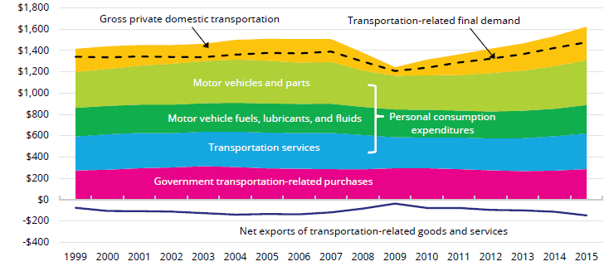
How Does Transportation Support
Economic Development (Vitality)?
Here’s where it gets tricky
  Direct Impacts (~9% nationally)
    Transportation sector jobs, roadway construction, freight brokers, drivers, etc.
  Indirect Impacts
    Businesses supported by transportation sector
      Consultants, equipment suppliers, insurance companies, etc.
  Induced Impacts
    An efficient transportation system (infrastructure) results in reduced prices
    Probably much more than 9% impact
<- This is probably what Congress was talking about

Slide 12
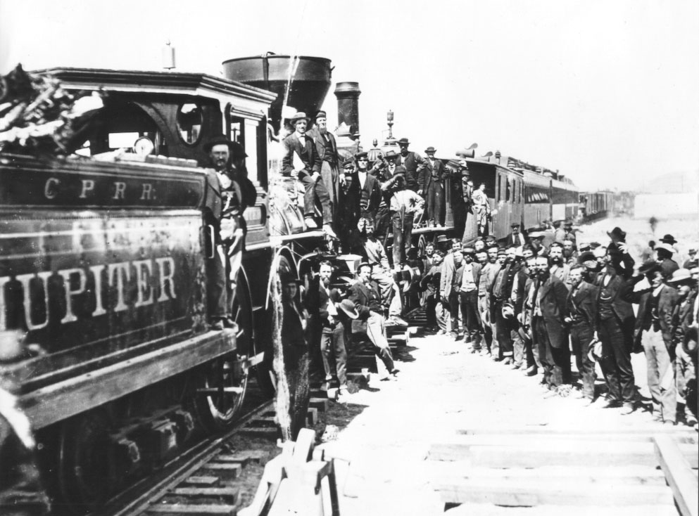

How Does Transportation Infrastructure Impact Economic Development?
Making land accessible for development or more intense development
  Faster and cheaper for inputs and raw materials to reach production
  Faster and cheaper to get goods and services to markets
  Faster and cheaper for workers and/or customers to reach businesses

Slide 13
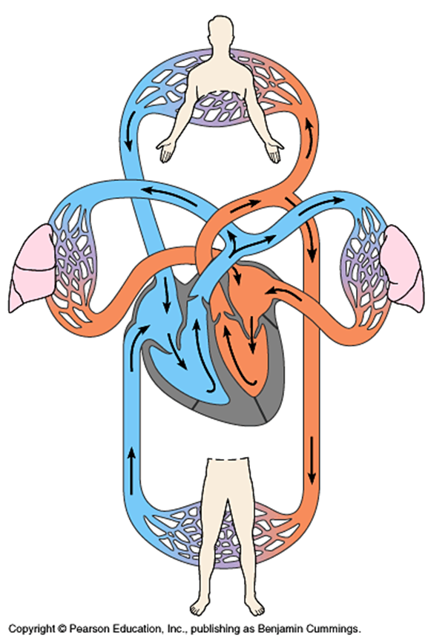
Circulation Infrastructure
Transportation moves “energy” (i.e., people and goods NOT vehicles) to the different organs of the city
  Good circulation keeps those organs alive; bad circulation leads to disease and maybe death
    Feed the needs

Slide 14
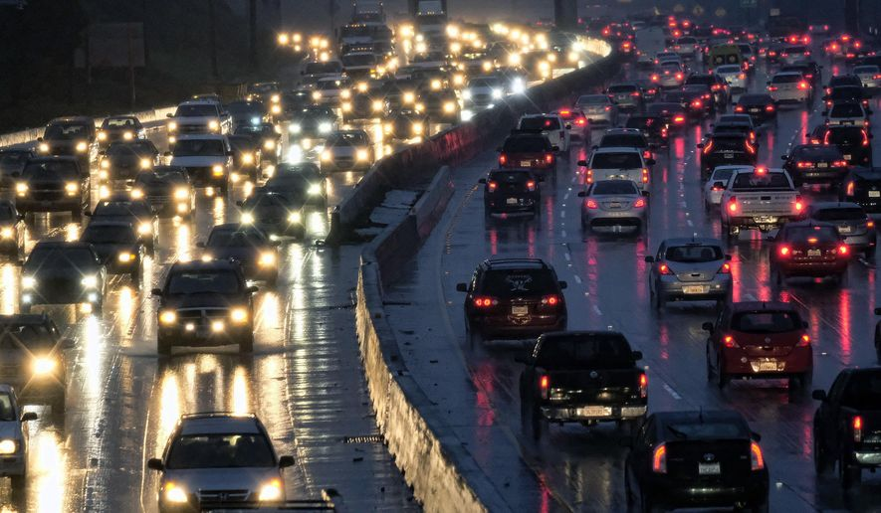
Isn’t “Faster and Cheaper” Just Another Way to Say Congestion Mitigation?
  Not entirely
    Faster and cheaper traffic does not necessarily comport with quality of life, well being, and other economic development (vitality) characteristics
    “Efficiency” is part of the charge
      Faster and cheaper but at what price?
        We also need to measure outcomes other than just congestion

Slide 15
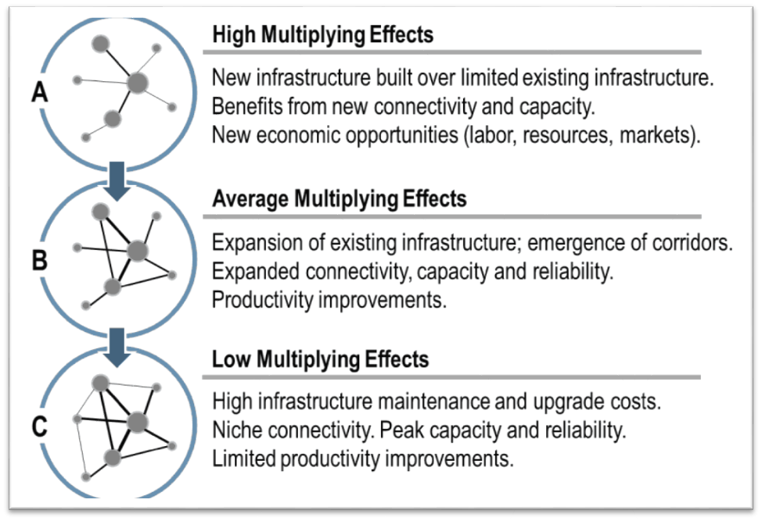
Finding the Sweet Spot
  Effective – gets the job done
  Efficient – gets the job done as inexpensively as possible
  Net positive productivity improvements (aka, economic growth)

Slide 16
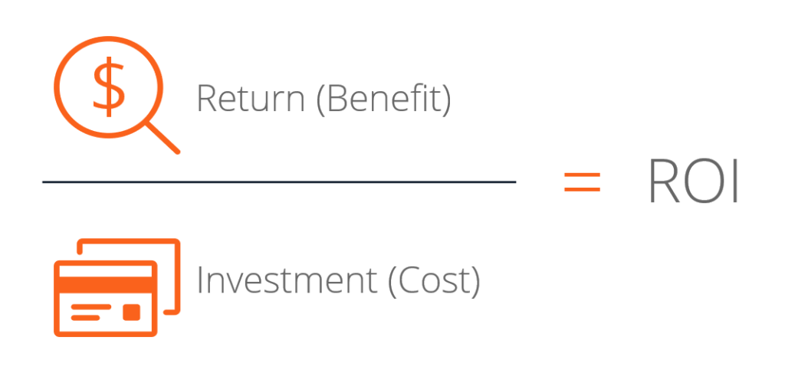
Return-On-Investment
  The city, like a private business, needs to make good investments
    If a city spends $1 million building a road, it should get at least $1 million (or more) back as a result of that investment
      Return = taxation
        Better accessibility (faster and cheaper transportation) should result in higher property values and, if applicable, more sales tax revenue for that property
          Indirectly – home ownership by employees, sales tax at stores visited by employees of that business, etc.
            The vines spread quickly

Slide 17
Return-On-Investment
  Property Value = C1 + ACCESS + H2O + GREEN + NOISE + INDUSTRIAL
    ACCESS is accessibility by activity type (i.e., employment, shopping, households)
    H2O is an index measuring adjacency to water
    GREEN is an index measuring green space
    NOISE is an index measuring noise from highways, railroads, airports, and other major transportation infrastructure
    INDUSTRIAL is an index measuring noise and other pollution from industrial facilities
      Buffer areas will need to be played with and adjusted until the equation produces reasonable results
      Other explanatory variables may need to be added

Slide 18
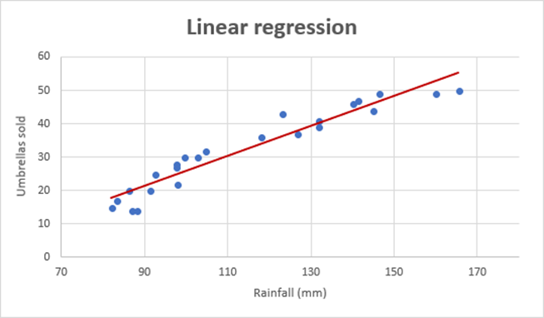
Return-On-Investment
  The goal (hope?) is to be able to predict with some accuracy, changes in property values (and thus tax revenue) resulting from changes in accessibility.
    Is it a better investment to widen a road, stripe bike lanes, or decrease transit headways?
    If we can only widen one roadway, is it a better investment to widen “this” one or “that” one?
    If we build this road, will it pay off in the long-run?

Slide 19

Return-On-Investment
  Next Steps
    Data collection
    Model validation
      Backcasting
    Defining “accessibility”
      What about non-business entities like schools, hospitals, etc. Can we capture accessibility impacts on those?

Slide 20
Measuring Economic Vitality
Freight Trucks
ROI
Transportation

Slide 21

This is Just the Beginning
Much more work to do on development of the regression
Goal:
  To develop better tool(s) that allow small- and mid-sized MPOs understand, measure, visualize, and predict transportation infrastructure impacts on the regional economy
Questions?
Brian Gibson
Executive Director
Saint Cloud APO
Gibson@stcloudapo.org

