Slide 1
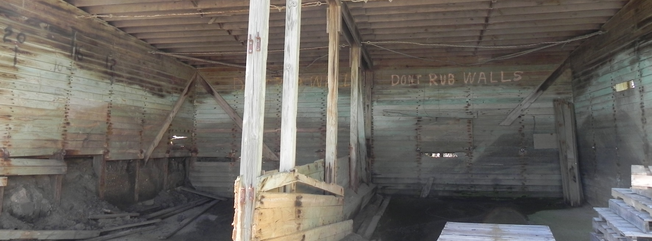
Minnesota Asset Management
Shannon Foss | Asset Management Planning Director
MPO Workshop August 27th 2019

Slide 2
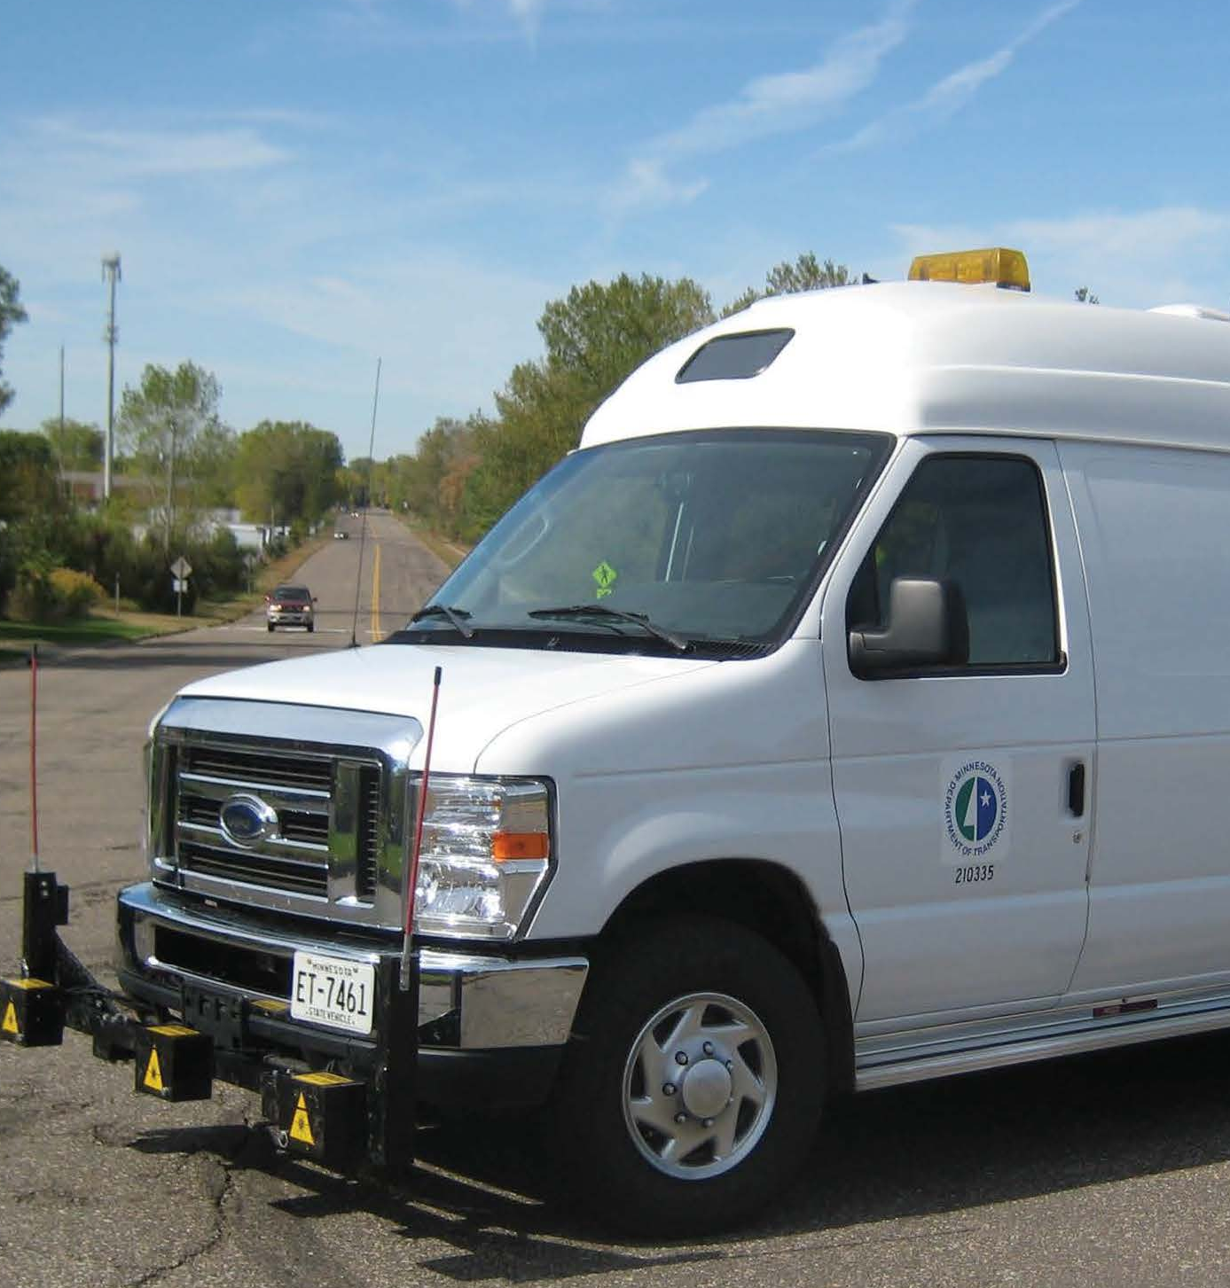
Agenda
MnDOT’s Transportation Asset Management Plan (TAMP)
Asset management Workshop/Peer Exchange
Why should asset management be important to you?
Group Discussion

Slide 3
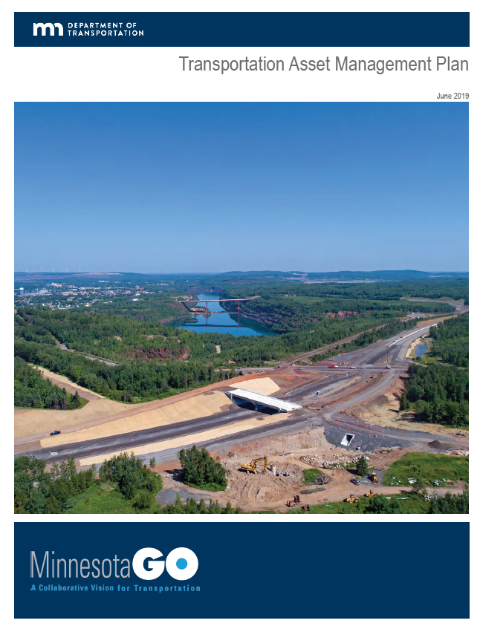
MnDOT’s Transportation Asset Management Plan
2012 MAP-21 AM legislation
2014 Pilot TAMP
2016 FHWA AM Final Rule
2018 Draft TAMP
2019 Final TAMP
2022 Next TAMP

Slide 4
Why is Asset Management
Important to MnDOT?
Pavements
Bridges
Culverts
Deep Stormwater Tunnels
High Mast Light Towers
Overhead Sign Structures
Pedestrian Infrastructure
Intelligent Transportation Systems
Noise Walls
Traffic Signals
Roadway Lighting
Buildings
The replacement value of MnDOT’s top 12 assets is: $48.7 Billion

Slide 5
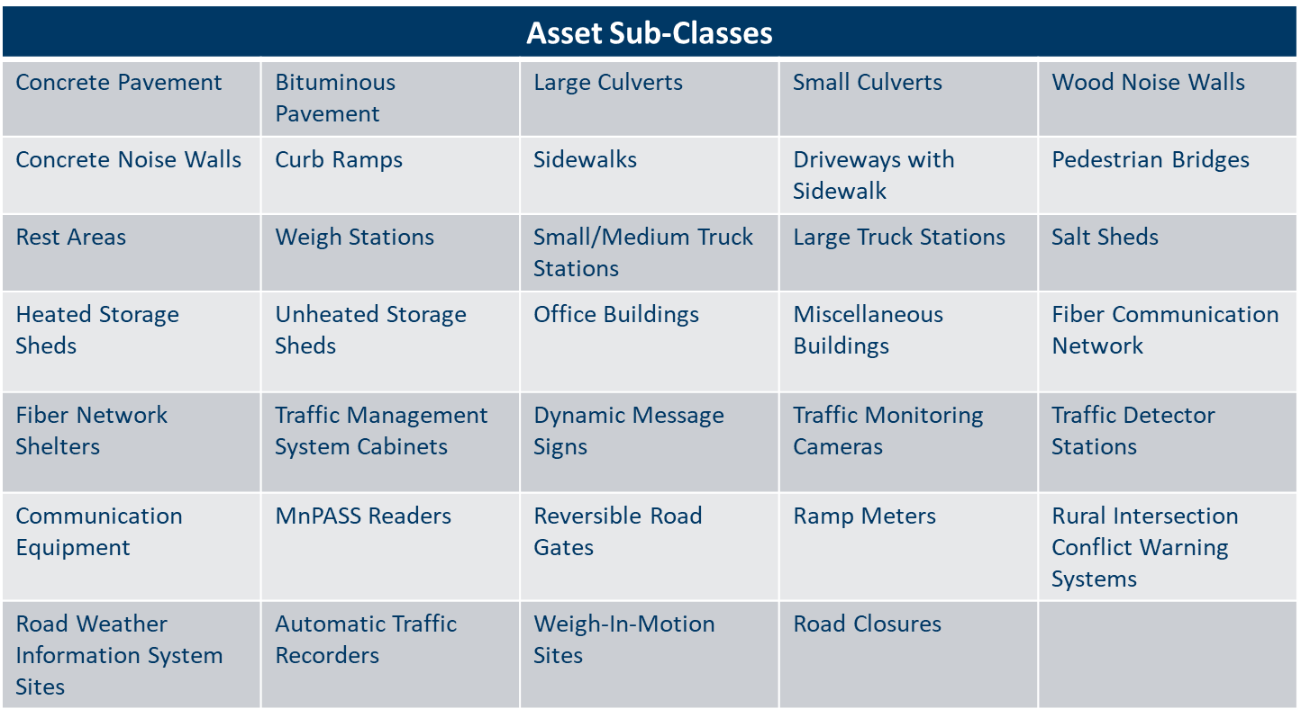
TAMP Assets

Slide 6
TAMP Topics
Inventory
Condition
Life Cycle Planning
Risk
Performance Gaps
Existing Framework
Performance Measures
Targets
Financial Plan
Investment Strategies
Implementation
Future Developments

Slide 7
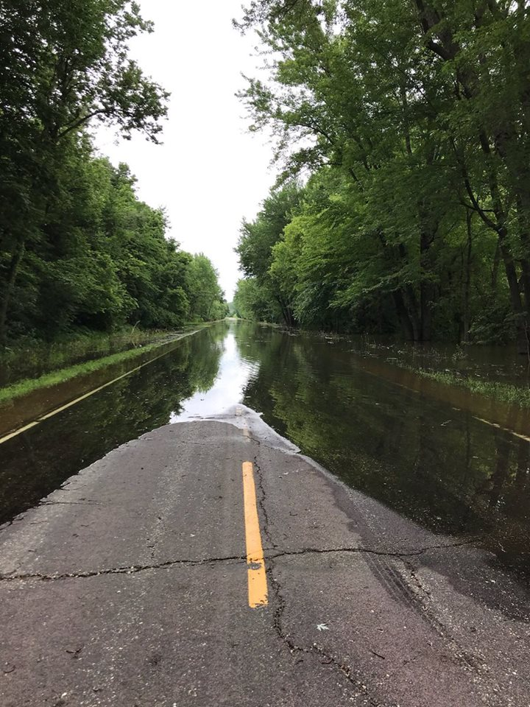
How will the TAMP be used?
Communication and accountability tool
  MnDOT
  Local Agencies
  MPO’s
  Legislature
  FHWA
AM Strategic Plan
AM Policy

Slide 8
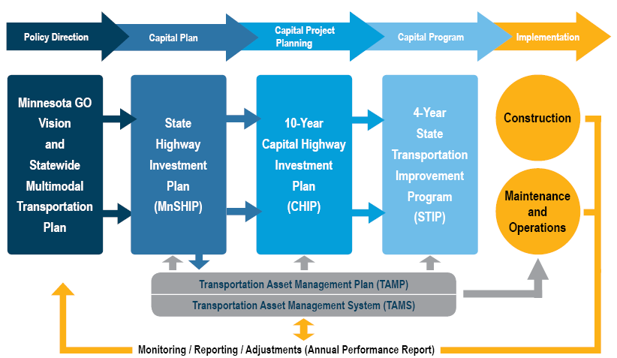
Planning & Programming
Framework

Slide 9
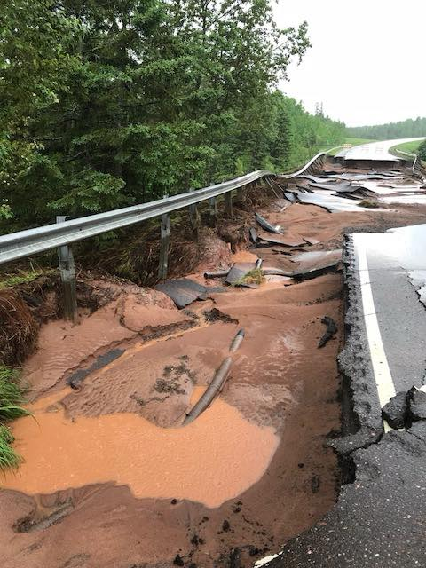
Implementation Challenges
Decentralized decision making
Competition for funds
Getting stakeholders to see their roles in implementation
Differentiating between TAMS (system) and TAMP (plan)
Asset trade-off decisions
Change culture to be preventive maintenance focused

Slide 10
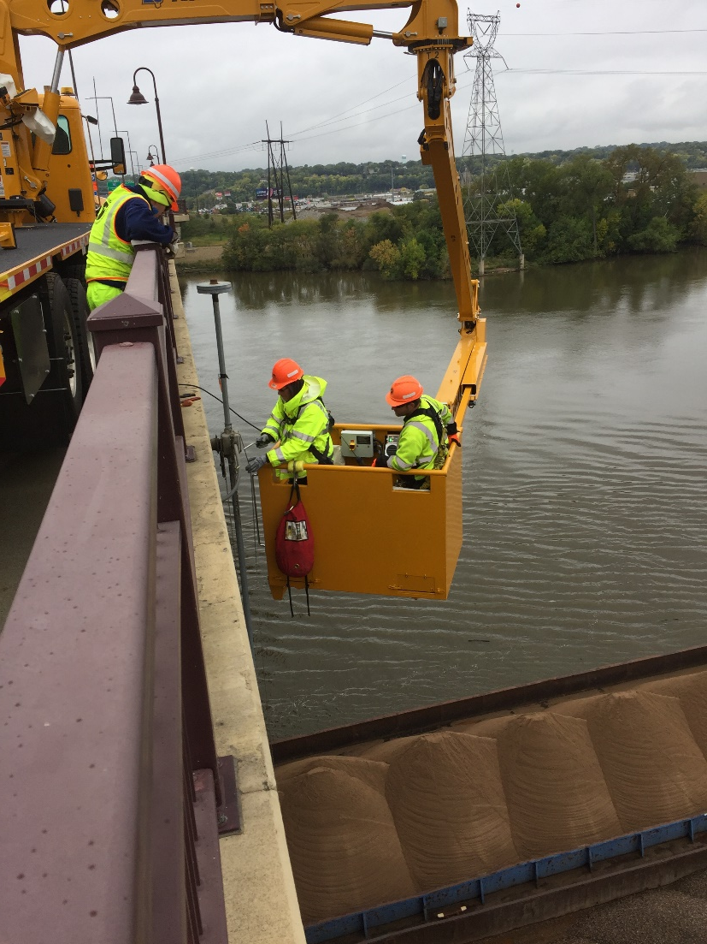
Implementation Successes
Engagement of asset program managers – passionate
Asset owners want their assets included in TAMP
Leadership Support
Resources – AMPO well supported
General buy-in
TAMS functionality, including better tracking of maintenance activities
AM Communications Matrix

Slide 11
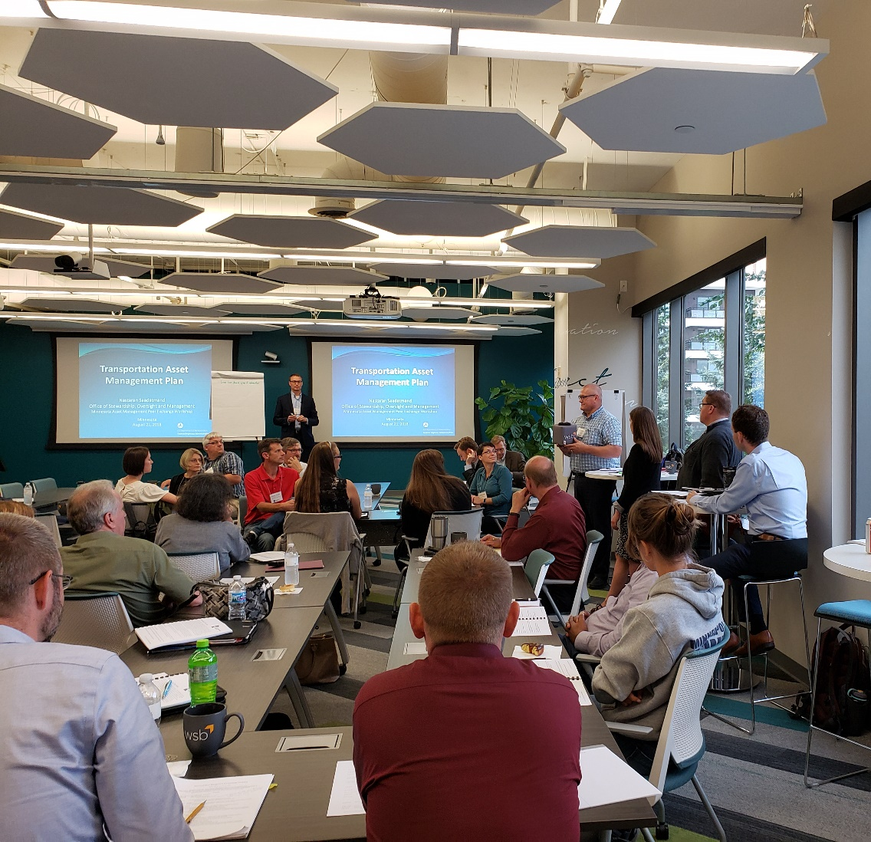
AM Workshop/Peer Exchange
2-Day Workshop with presentations and facilitated discussions
Partnered with Institute of Asset Management (IAM) – MN Chapter
August 21st-22nd, 2019
67 Attendees
Counties, Cities, FHWA, Metropolitan Council, IAM, and Consultants

Slide 12
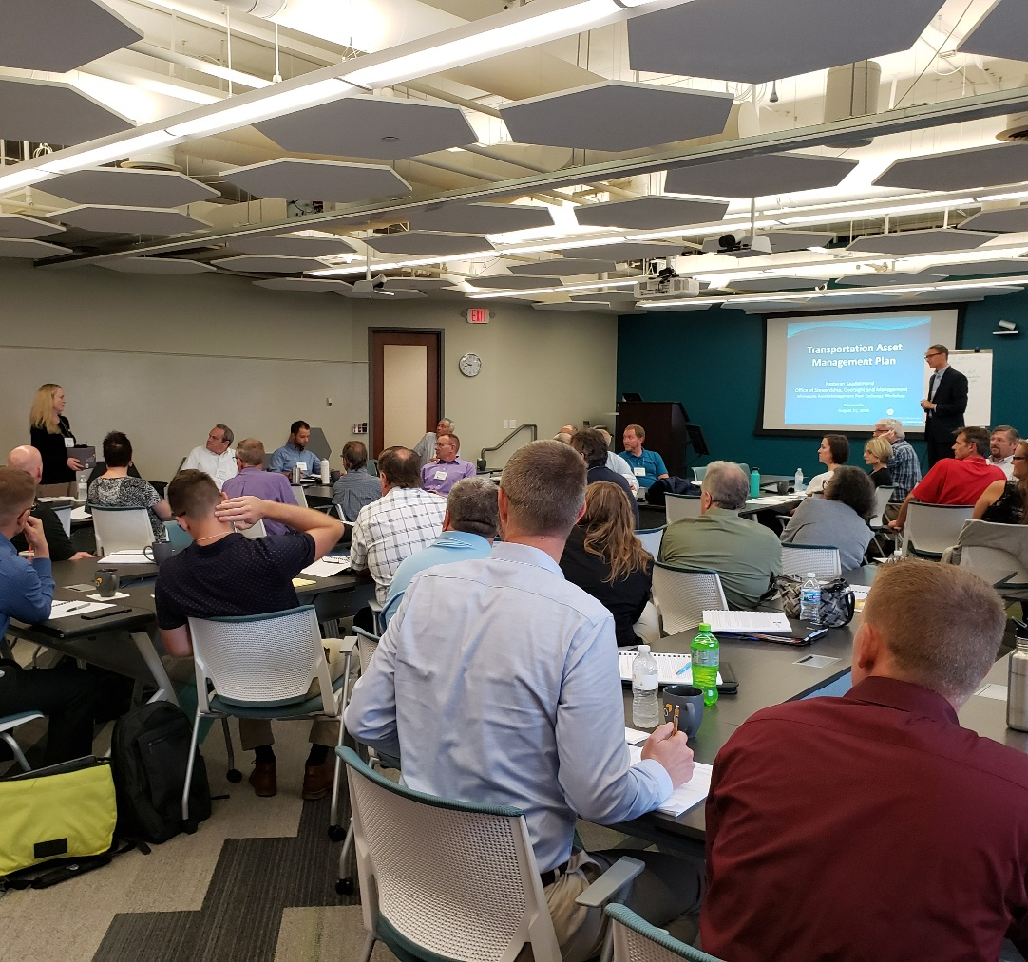
AM Workshop/Peer Exchange
6 AM Topics
  Current Asset Status
  Levels of Service
  Risk and Criticality
  Operations/Maintenance, Life Cycle Planning
  Funding Strategies
  Implementation

Slide 13
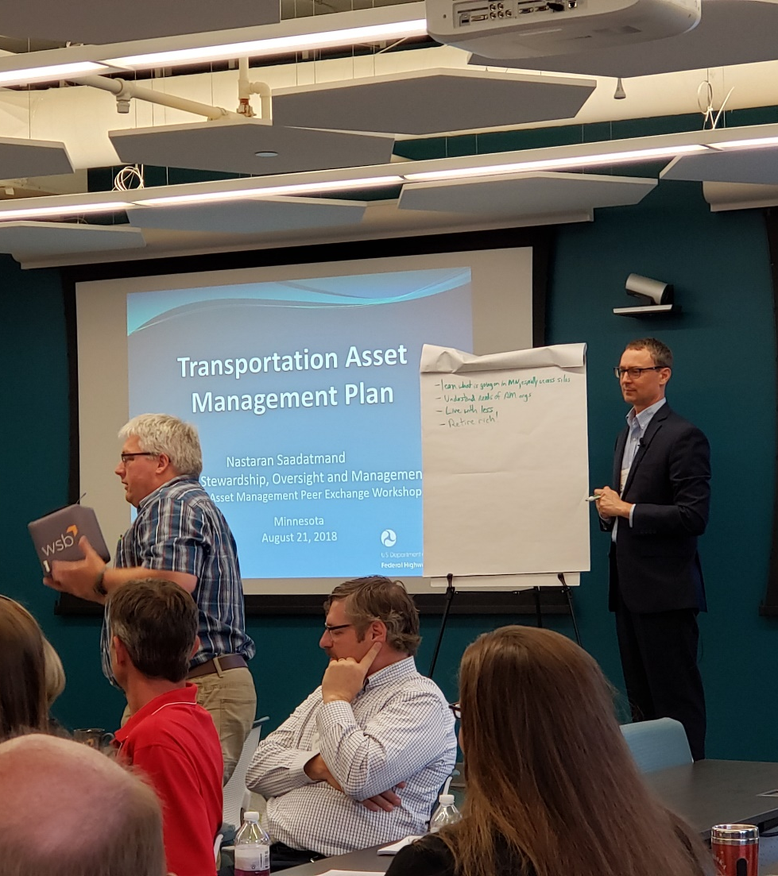
AM Workshop/Peer Exchange Themes
“What is the definition of AM?”
“Are we already doing AM?”
“Where do we begin?”
“Our most critical assets are those in worst condition”
“Our work is driven by pavement projects”

Slide 14
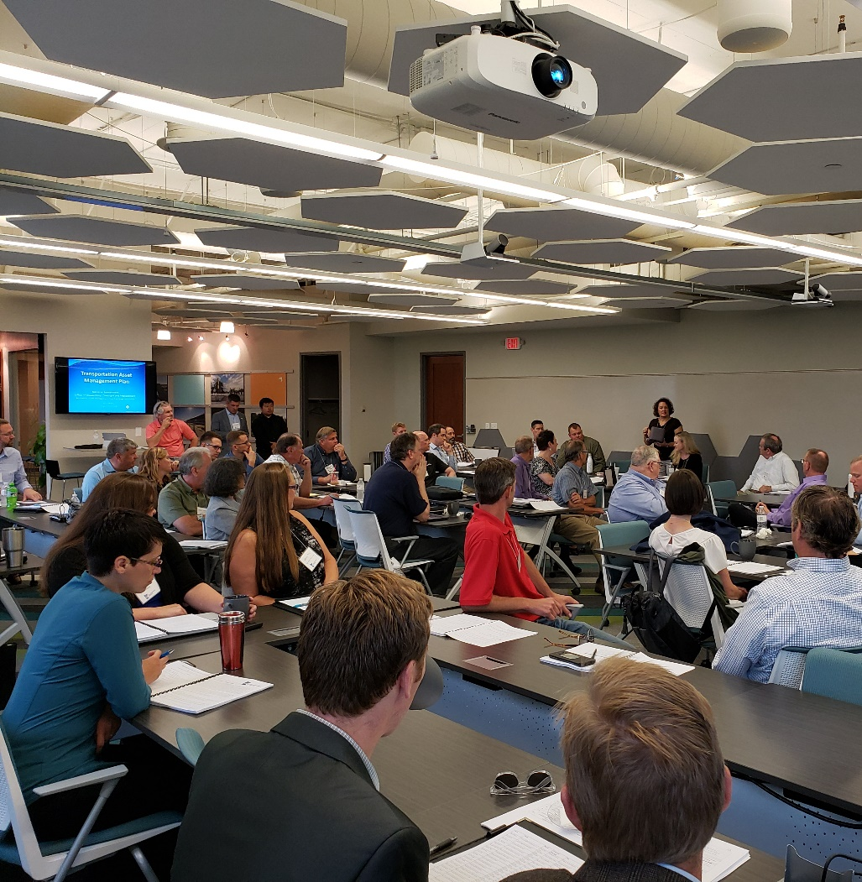
AM Workshop/Peer Exchange Themes
“We don’t have dedicated staff”
“AM functions in GIS group”
“AM is a database”
“People like being ‘firefighters’”
“We focus on what may potentially be in the news”

Slide 15
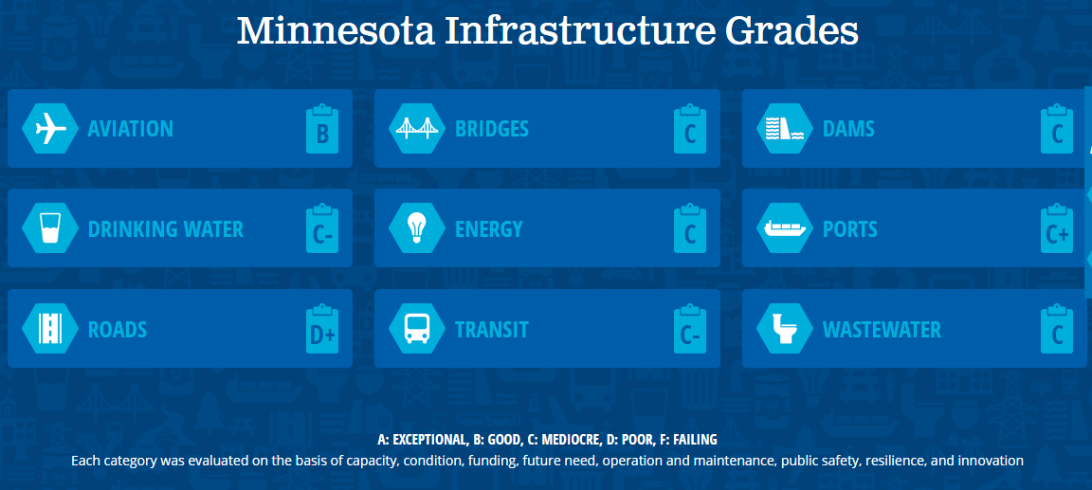
Why should asset management be important to you?
ASCE infrastructure report card

Slide 16
Why should asset management be important to you?
Minnesota Section of the American Society of Civil Engineers (ASCE) 2018 State Report Card
To raise the grades, there were 5 recommendations – one being:
Implement robust asset management programs so that entities may better prioritize limited available funding and make smart decisions.

Slide 17
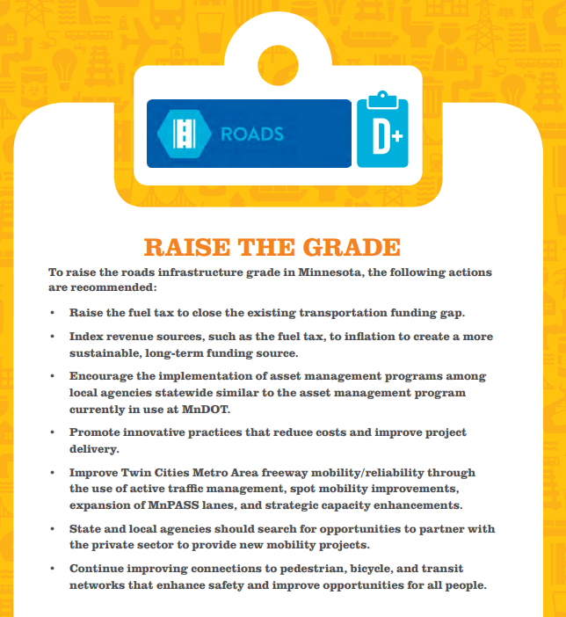
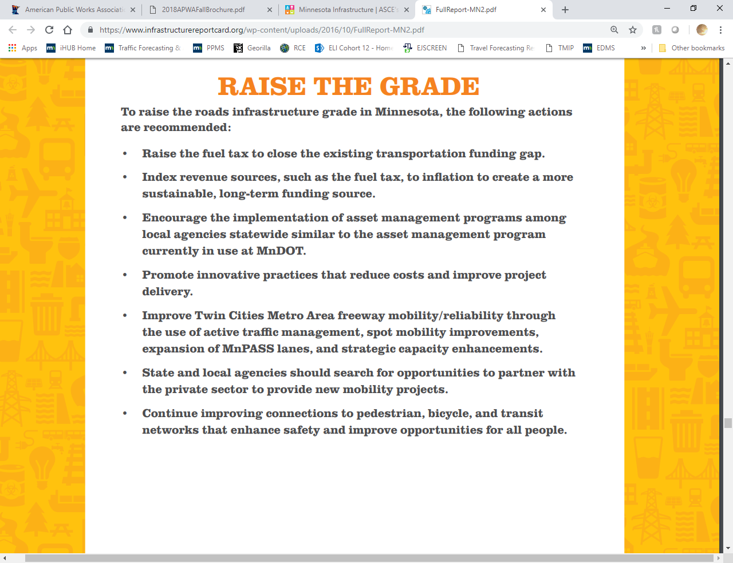
Why should asset management be important to you?

Slide 18
Asset Management
What is your role in implementing an asset management approach?

Slide 19
Asset Management
What are local agencies talking about?

Slide 20
Asset Management
What are your barriers to implementing AM?

Slide 21
Thank you!
Shannon Foss
Shannon.foss@state.mn.us
651-366-3878

