Slide 1
Travel Analysis and Data Visualization in Minneapolis-St. Paul David Burns Metropolitan Council
2019 Minnesota MPO Summer Workshop
August 28, 2019

Slide 2
Agenda
About the Met Council
Recent Met Council/MnDOT Metro District projects
Speed/congestion analyses
Facility users/origin of traffic
Corridor analyses
Transportation Flows Dashboard
VMT and Greenhouse Gas Emissions Analysis
Potential uses of big data for MPOs

Slide 3
What we do:
Regional Transit
Transit ridership over 95 million annually
Water and Wastewater
$7 billion dollar system that serves 2.7 million residents
Parks
55 regional parks, 360 miles of trails
More annual visitors than Yellowstone, Yosemite and the Grand Canyon combined
Housing
Administers over 6,500 HRA vouchers in 96 communities
Planning
1976 Land Planning Act directs the Met Council to adopt regional plans every 10 years and review/approve comprehensive plans for all 187 local communities
Transportation
Serves as the region’s MPO
Distributes $200 million in funds for transportation projects throughout the region bi-annually
Notes:
Over 4,000 employees (roughly 20-25 MPO planning staff)
7-county metro area population of over 3.1 million
Governed by a 17-member body that is appointed by the Governor of Minnesota
We also serve as the MPO for the region, and as a TMA are responsible for the competitive solicitation of funds for transportation projects (the Regional Solicitation process). Roughly $200 million competitive process every 2 years.
Our transportation planning functions include:
Highway planning
Transit Planning
Airport Planning
Freight Planning
Travel Forecasting
Corridor and System Studies

Slide 4
StreetLight Insight Basics
Subscription service that uses a cloud-based, online software tool to generate analytics (metrics) about trends in transportation behavior
Transportation metrics derived from both navigation-GPS records and location-based services records
Transportation data collection tool that allows authorized users:
To run an unlimited number of transportation studies and analyses including Origin-Destination
To run these studies and generate analytics directly from a computer with only an internet connection, no software is required
Notes:
Provider of anonymized location-based services data from cell phones
Can’t identify individuals, can only look at patterns of travel
23% of the U.S. and Canadian adult population
60 billion location records/month
Travel mode, visitor home/work location (Census block group), demographics
Many types of analyses available
Some pros and cons
Pros:
Processing power (would take significant hardware resources to perform these analyses in-house)
Data storage (massive datasets, cloud-based storage)
Technical support: StreetLight staff provides frequent trainings and quick response to questions
These analyses would require highly trained staff and significant software investment – not practical for most organizations
User interface is simple and easy to use
Cons:
Subscription as service – you don’t “own” the data
If you don’t subscribe you lose the data

Slide 5
StreetLight InSight Program Highlights
Speed/Congestion Analysis
Traffic Origin of Funded Highway Projects
Corridor Analysis
Transportation Flows Dashboard
VMT and Greenhouse Gas Emissions Analysis

Slide 6
Speed and Congestion Analysis
Measured all arterials in the Met Council planning area
July 2016 through June 2017
Peak periods of 6-10 AM & 3-7 PM
“Gates” were drawn in StreetLight at the endpoints of each roadway segment
Peak period speeds are compared to an off-peak/free flow “reference speed” (12:00 a.m. to 6:00 a.m.)
Congestion was defined as the percent difference in peak period speeds versus free flow (overnight) speed
In total, 8,995 “segments” were created and analyzed
Notes:
This project was a test to see if StreetLight could be used to replicate a 2013 project in which MnDOT partnered with TTI to measure arterial mobility performance
The 2013 project was used travel speed data from INRIX, took 6 months to complete and cost over $100,000

Slide 7
Speed and Congestion Analysis
Segment Analysis tool in StreetLight
All trips that pass through both start and end gate
Average trip speed along segment
Average trip duration
Distribution of speeds and duration over segment
Notes:
Our interns created some “segments” in GIS and imported them into StreetLight
Segments have both start and end gates
We spent some time manually editing the automatically generated gates

Slide 8
Quantifying Congestion
Example – Roadway X:
Free-flow (reference) speed: 68 mph
Speed at 5:00 p.m.: 47 mph
47/64=0.73
Segment X is 73% of reference speed at 5:00 p.m.

Slide 9
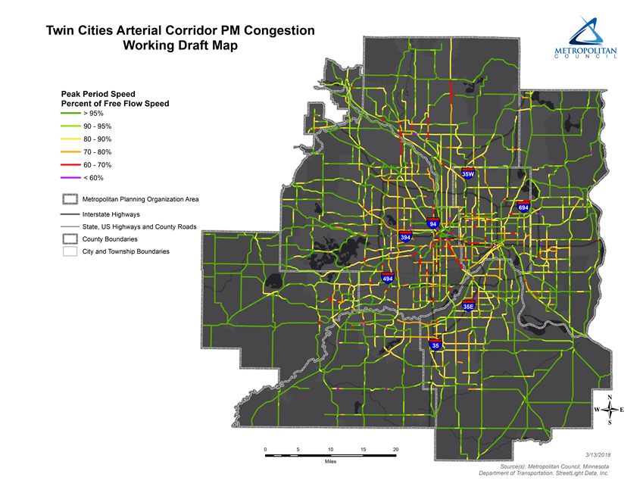

Slide 14
Project Outcomes
Previously a similar study was conducted by MnDOT on a much smaller portion of the roadway network, where existing instrumentation was present
StreetLight tool allowed us to expand this to all functionally classified roadways within the Twin Cities metro area
Notes:
The “model” for this project was a 2013 study conducted by MnDOT, which occurred solely on higher volume roadways where existing traffic instrumentation was present
The 2013 project was used travel speed data from INRIX, took 6 months to complete and cost over $100,000
To replicate this project for the non-freeway system, the cost is estimated to be more than $350,000.
Through the use of streetlight, we were able to greatly expand this analysis to include all major roadways in the metro area. This was not possible prior to the Council having access to this data.

Slide 15
Potential Issues
New technology: credibility with stakeholders
Understanding and explaining sample size
Issues with methodology
Size of input GIS files
Difficulty ensuring segmentation aligned with correct corridor on the StreetLight platform
Notes:
Some of the issues we had included:
New technology: having to explain that it isn’t a “black box”
Explaining that the output does NOT represent actual counts, but rather a index which can be used for comparison
We had some issues with directionality that caused us to have to manually draw the direction of the automatically generated gateways
GIS shapefiles contained too many segments – had to break it up for faster processing
Alignment issues with our GIS shapefile and OpenStreetMap

Slide 16
Traffic Origin of Funded Projects
How do we measure geographic balance in the Council’s Regional Solicitation?
Staff and stakeholders wanted to know/show that projects located in a particular location have a region-wide benefit
Used StreetLight to show the origin of traffic for projects passing along project corridors
Who benefits from major highway improvement projects?
Notes:
We often hear that our Regional Solicitation funding is biased towards certain counties/areas as compared to other counties areas
Wanted to perform an analysis that doesn’t just account for where the project is located, but who are the users of the project
Demonstrates that even though a project may be geographically located in a particular area, its positive effects are felt by users throughout the area

Slide 17
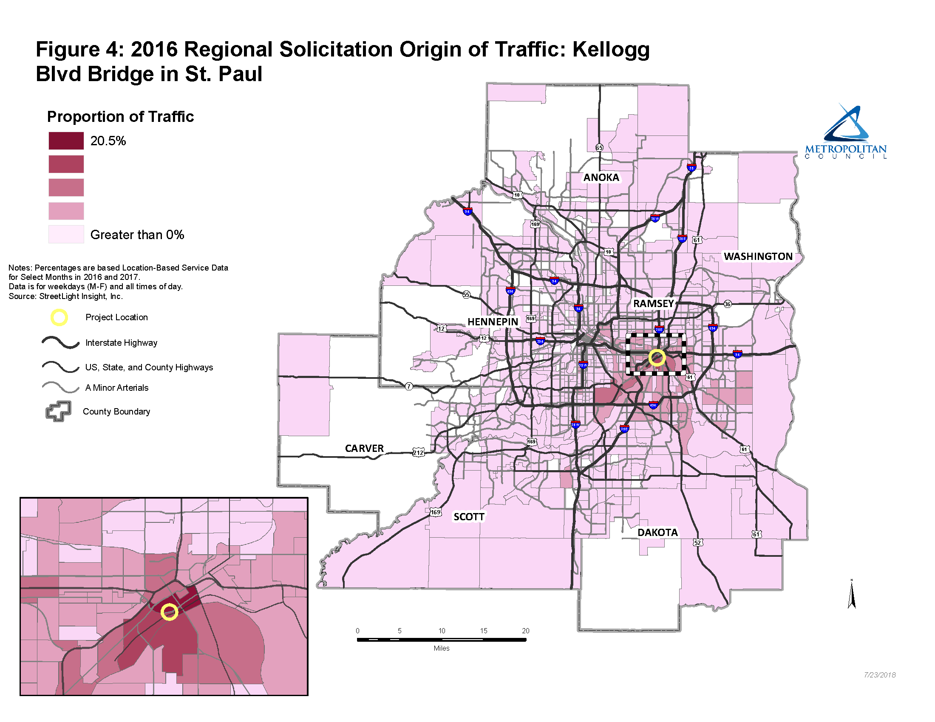
Notes:
Shows origin census tracts for trips that passed through a gate placed along the project
Highest is still only 20.5% - shows that this project benefits people from throughout the metro area
Used LBS data for 4 months covering 2016 and 2017

Slide 18
Project Outcomes
Quantified the fact that projects which are funded/constructed have a region-wide benefit
Helped us understand the travel behavior of individuals travelling to downtown St. Paul
Graphically depicts to partners/stakeholders the regional nature of funded projects
Notes:
Helped us understand the travel behavior of individuals travelling to downtown St. Paul
Where do they come from?
How should we invest in the system to accommodate travelers to employment/commercial hubs?
Easy to show to stakeholders/local officials

Slide 19
Maryland Avenue Corridor Analysis (St. Paul)
Who’s using this corridor?
What were the effects of the 4-to-3 lane conversion on traffic patterns, trip length, and speed along Maryland Avenue?
What was the effect of the closure of Wheelock Parkway? Did traffic volumes substantially increase along other roadways due to the Wheelock closure?
Notes:
Staff wanted to get a sense of how Maryland Avenue is generally being used.
Is it primarily a street used by local residents and for local trips? Is it used as a corridor to connect commuters from eastern suburbs to I-35E? Is it a significant destination?
Next, due to some complaints by residents, we wanted to understand the effects of the trial 4-3 lane conversion on traffic patterns and speed.
Was there a significant decrease in speed/increase in trip length due to the 4-3 conversion?
Simultaneously, Wheelock Parkway was under construction and completely closed to traffic for a period of time during the 4 to 3 conversion. Was this complicated by the Wheelock closure? Did traffic divert from Maryland to other east/west connections (e.g. Phalen)?

Slide 20
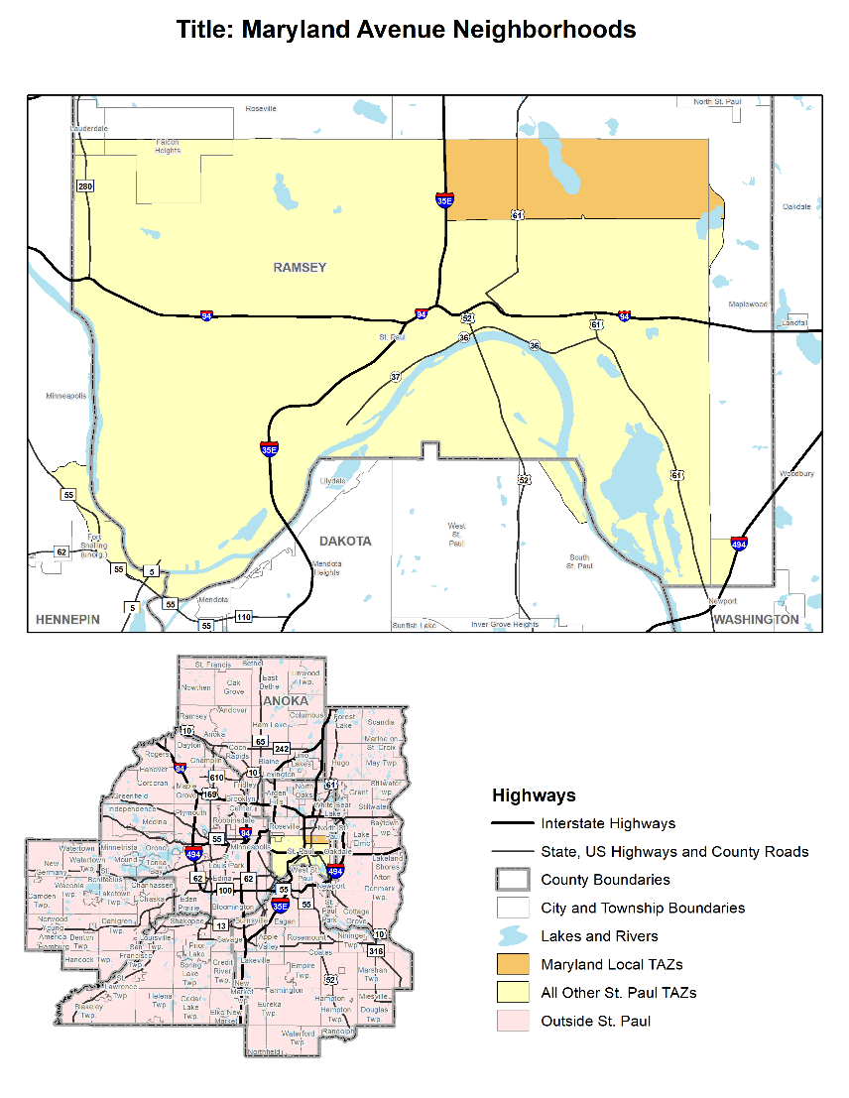

Slide 21
Destination of Maryland Avenue Corridor Users
Notes:
Using StreetLight Insight GPS data, the three geographies (Maryland Area, Other St. Paul, Outside St. Paul), and a few “gates” on Maryland Ave as middle filters, we were able to determine:
Overall, 71% of users along Maryland Avenue had either an origin, destination, or both O/D with the Maryland Neighborhood area
Only 4% of trips had both an origin and destination outside of St. Paul; the majority of non-St. Paul trips had a destination within the neighborhood.

Slide 22
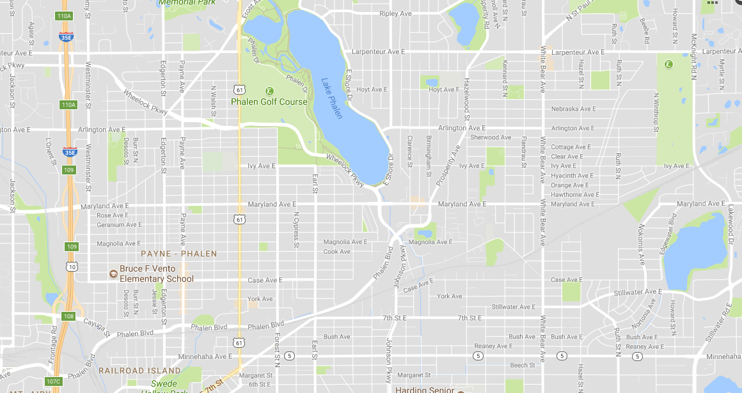
Wheelock Pkwy
Closed to Traffic Mid-June through August
Maryland Ave
Phalen Blvd
Notes:
Green – Maryland Avenue. 4-3 conversion with center left turn lane
Initiated May of 2017, “test conversion for a few months to see effect”
Red: Wheelock Pkwy. Closed for construction of new sewer pipe lines
Completely closed in July, partially closed in June and August
Orange: Phalen Blvd: how much traffic was diverted to Phalen due to the 4-3 conversion and the Wheelock closure?

Slide 23
Effects of 4 to 3 Conversion and Wheelock Closure
Traffic on Wheelock did decrease, but not as much as anticipated
Number of trips, duration, and length increased on adjacent roadways during the Wheelock closure
Some evidence that 4 to 3 conversion may have increased trip duration
Despite increased number and duration of trips, average speed on Maryland Avenue increased after 4 to 3 conversion
Notes:
In order to get a sense of how traffic was impacted by both the 4 to 3 conversion and Wheelock closure and if (and to what extent) traffic was diverted from Maryland to adjacent (Phalen) roadways, we performed an analysis of traffic patterns and travel time along the three roadways. The analysis compared the July 2016 data (when Wheelock was open and prior to the 4-3 conversion) to July 2017 data.
Traffic along Wheelock may not have decreased as much as expected due to roadway being open for local traffic and construction
The number of trips, trip duration, and the average trip length (in miles) increased on adjacent roadways due to the Wheelock closure
The 4 to 3 conversion may have increased trip duration, but this may also be compounded by the Wheelock closure
In spite of the greater number of trips and increased trip duration, the average speed on Maryland actually increased after the 4 to 3 conversion

Slide 24
Project Outcomes
By utilizing the StreetLight InSight tool, staff was able to determine:
The majority of trips along Maryland Avenue had their origin, destination, or both origin and destination within the immediate neighborhood; very few suburban residents were using the corridor as a “pass through” to connect to I-35E
The closure of Wheelock Parkway led to a substantial increase of traffic along adjacent corridors
StreetLight allowed staff to understand and function of a corridor as well as provide a picture of the effects of roadway reconstruction on speed, traffic patterns, and trip duration.
Notes:
Outcomes/uses:
Origins and destinations of trips and nature of trips along residential corridor
Impact of traffic due to construction closure
Travel time and speed changes due to a 4 to 3 lane conversion or road diets in general.
Would have required a number of traffic counters to perform this in the past; very costly and time consuming to set up and process

Slide 25
Transportation Flows Data Visualization
Public location, data available for download
www.metrocouncil.org/transportationflows
Multi-purpose
Demonstrate travel behavior that consistently crosses municipality & county borders, for a variety of reasons (Regional Solicitation & geographic balance of funding)
Provide a more granular look at travel sheds that’s not possible with a static report (cities/township-level instead of county)
Includes larger datasets with better sample sizes
Notes:
Multi-purpose dashboard
People are crossing geographic (county/city) borders as the time
We wanted to illustrate that what happens outside of a particular county/city has an impact for residents of other counties/cities

Slide 26
Key Use Cases & Specific Analyses Relevant for MPOs
1
2
3
Understand Facility Use
Project Prioritization
Before/After Performance Measurement
Trip lengths of vehicles on a road
Activity of pedestrian or bicyclists
Inferred home place (zip code, CBG) of drivers – regional vs local
Traffic Diagnostics feature
Top Origins/Destinations for drivers on particular routes
Speed and travel time on any type of corridor
Demographics of travelers – ensure equity

Slide 27
Potential MPO Uses
Congestion Management Process (CMP)
Defining the CMP network/identifying corridors of concern
Simple origin/destination analyses using multiple geographic boundary types
Determine the origin and/or destination of users of a particular roadway/interchange
Speed and travel time on corridors
Evaluating the effectiveness of implemented strategies
AADT and VMT estimates
Network performance and congestion analyses
Notes:
Tool for overview of origins/destinations within the region
Monitor traffic volumes along corridors and their change over time
Cost savings: the three ND MPOs recently participated in a joint purchase of one year’s worth of AirSage data for development of models for 2045 MTP
Cost of data was approximately $90,000, with additional costs devoted to staff time and consultants hired to process data
StreetLight has capability to provide the required O/D data without the need for additional data purchase or costs associated with data processing

Slide 28
Potential MPO Uses (cont.)
Bike/ped planning
Roadway functional classification reviews
Equity impacts
Freight analyses (large and medium-sized trucks)
Transit planning
Construction impacts and detour analyses
Assist in MPO’s model development/calibration
Potential for significant long-term cost savings
Better communicate system performance with policy makers, the public, and partner agencies
Notes:
Cost savings: the three ND MPOs recently participated in a joint purchase of one year’s worth of AirSage data for development of models for 2045 MTP
Cost of data was approximately $90,000, with additional costs devoted to staff time and consultants hired to process data
StreetLight has capability to provide the required O/D data without the need for additional data purchase or costs associated with data processing

Slide 29
David Burns
Senior Highway Planner
David.Burns@metc.state.mn.us
651-602-1887

